Slide 1
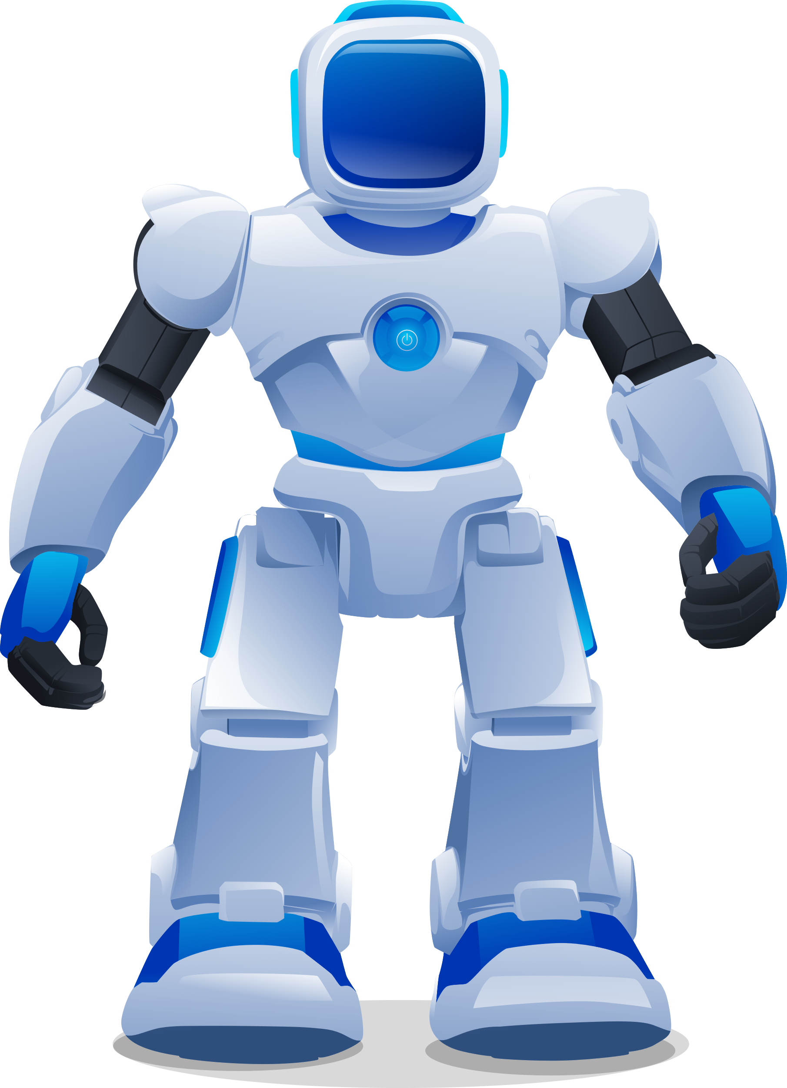
Title Of The Project:
“AI BASED PONG GAME”
Software Used:
Anaconda(Jupyter)
Library Used:
Pygame

Slide 2
Pong game:
HOW IT WORKS?

Slide 3
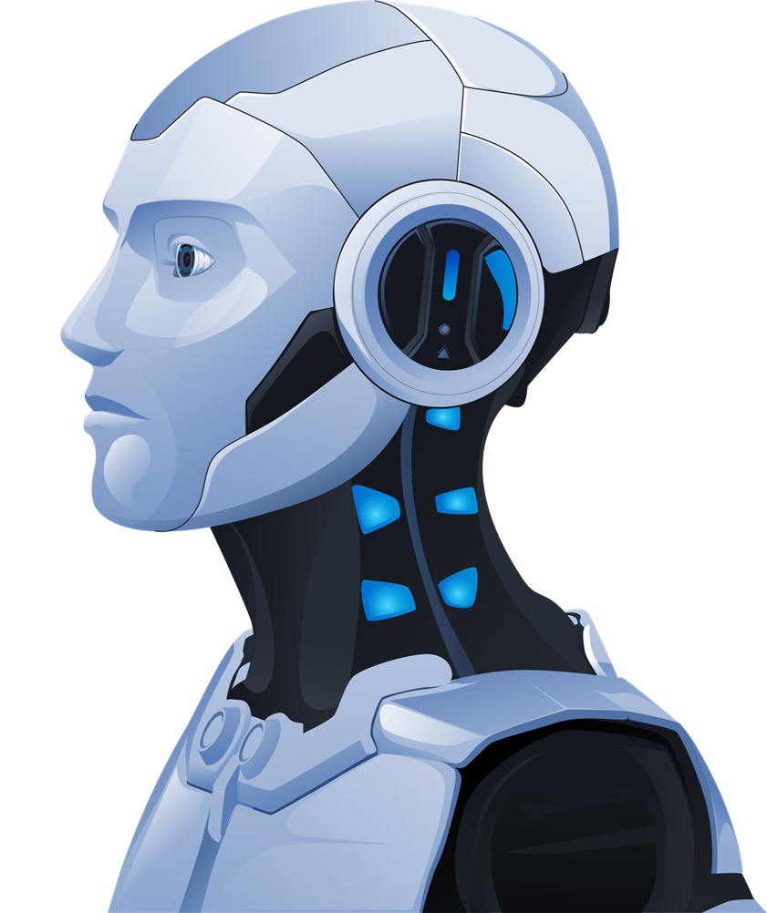
Description Of Game:
Pong is a classic video game that features a simple and easy-to-understand concept.
It is a two-player game where each player controls a paddle on a screen.
The objective is to hit a ball back and forth using the paddles without letting the ball pass behind your own paddle.
Players score points when the opponent fails to return the ball successfully

Slide 4
Components Of pong game:
Paddles
Balls
Game area
Score display
Collision detection
Game logic
Input controls

Slide 5
Algorithm That Are Used In Pong Game:
Here are some algorithms commonly used in Pong game development:
Collision detection algorithm
Paddle movement algorithm
Ball movement algorithm
Scoring algorithm
AI algorithm
Game loop algorithm

Slide 6
Benefits Of AI Based Pong Game:
Playing an AI based pong game offers several benefits:
Challenging Gameplay
Adaptive difficulty
Skill development
Availability & convenience
Solo & multiplayer options
Experiments & customization

Slide 7
Conclusion:
In conclusion, AI-based Pong games offer challenging gameplay, skill development opportunities & customization options with modern technology.
They provide an engaging and convenient gaming experience for players of all skill levels, combining the classic appeal of Pong with the advancements of AI technology.

Slide 8

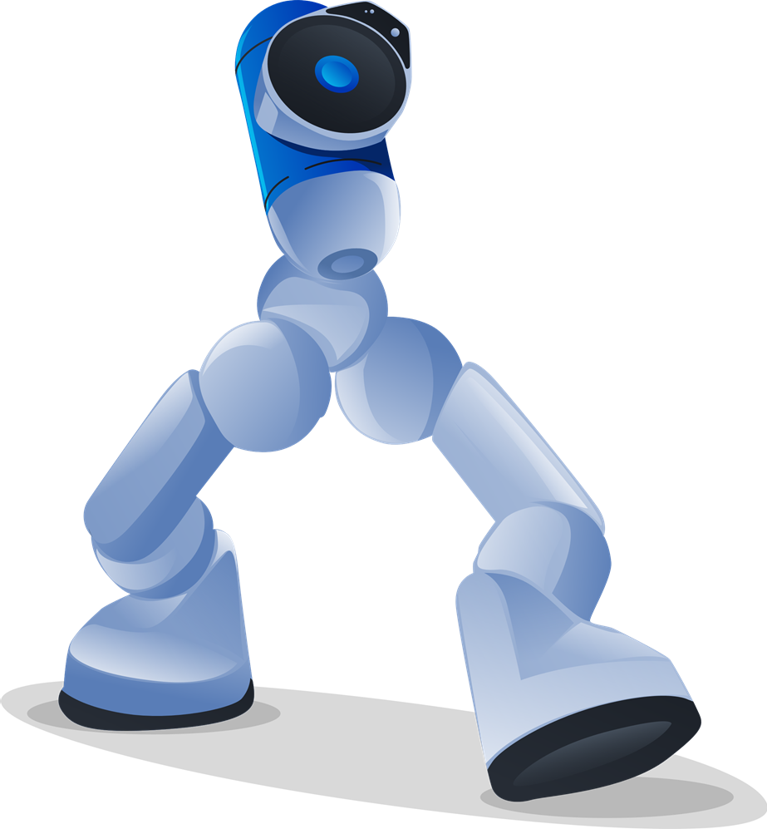
THANKYOU FOR LISTENING!!!!

